Slide 1
ELEC5566M FPGA Design for System-on-Chip
Assignment 1
Unit 2.1
Prof Steven Freear Module Leader s.freear@leeds.ac.uk
Dr David Cowell

Slide 2




Reading List - reminder

Slide 3
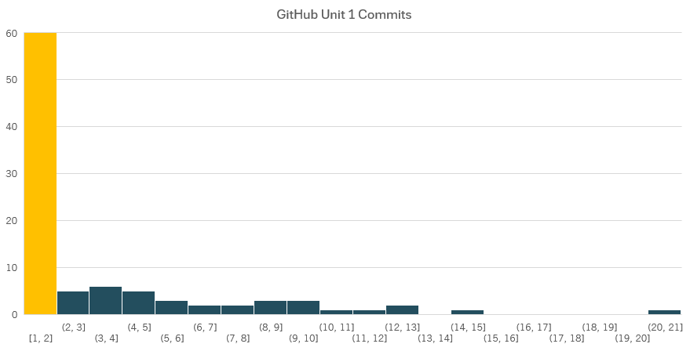
GitHub Classrooms
42 candidates have not signed up to GitHub Classrooms for ELEC5566M! Cannot pass ELEC5566M without using GitHub. Not engaged. 60 candidates have not used Committed AND Pushed any code to GitHub! Commit code and push from GitHub desktop (See GitHub Intro lecture). Check GitHub.com code shows.

Slide 4
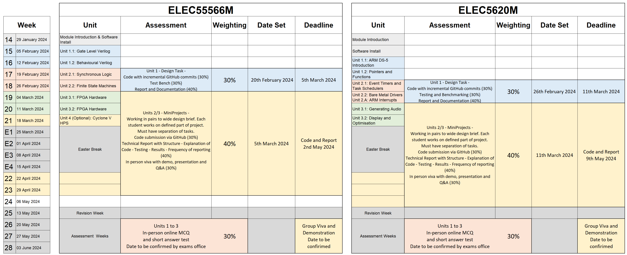
Assessment Summary – ELEC5566 Assessment Summary
ELEC5566M
Note overlapping assessments

Slide 5
ELEC5566M FPGA Design for System-on-Chip
Assignment 1 Deadline 5th March 2024 at 2pm
Prof Steven Freear Module Leader s.freear@leeds.ac.uk
Dr David Cowell

Slide 6
Minerva > ELEC5566M > Assessment and Feedback Assignment 1 – Unit 1 Design Task
See Minerva > ELEC5566M > Assessment & Feedback > Assignment 1: Unit 1 Design Task
Complete the hierarchical gate level design of 2x3 bit multiplier
Use Template repository provided ELEC5566M-Assessment1 Use link on Minerva to create your repo.
Three empty modules to complete - top level design, top row, and bottom row
Use the Adder1Bit module from Unit 1
Add it as commit, citing original author the source of the code in the commit message.
Design Testbench and perform exhaustive verification
2 page written report!
Incremental GitHub code commits of functional Verilog code and Testbench
Github online documentation using the readme
Read and follow guidance in assignment brief carefully
30% of module – Read rubric on Minerva and use to inform your submission.

Slide 7
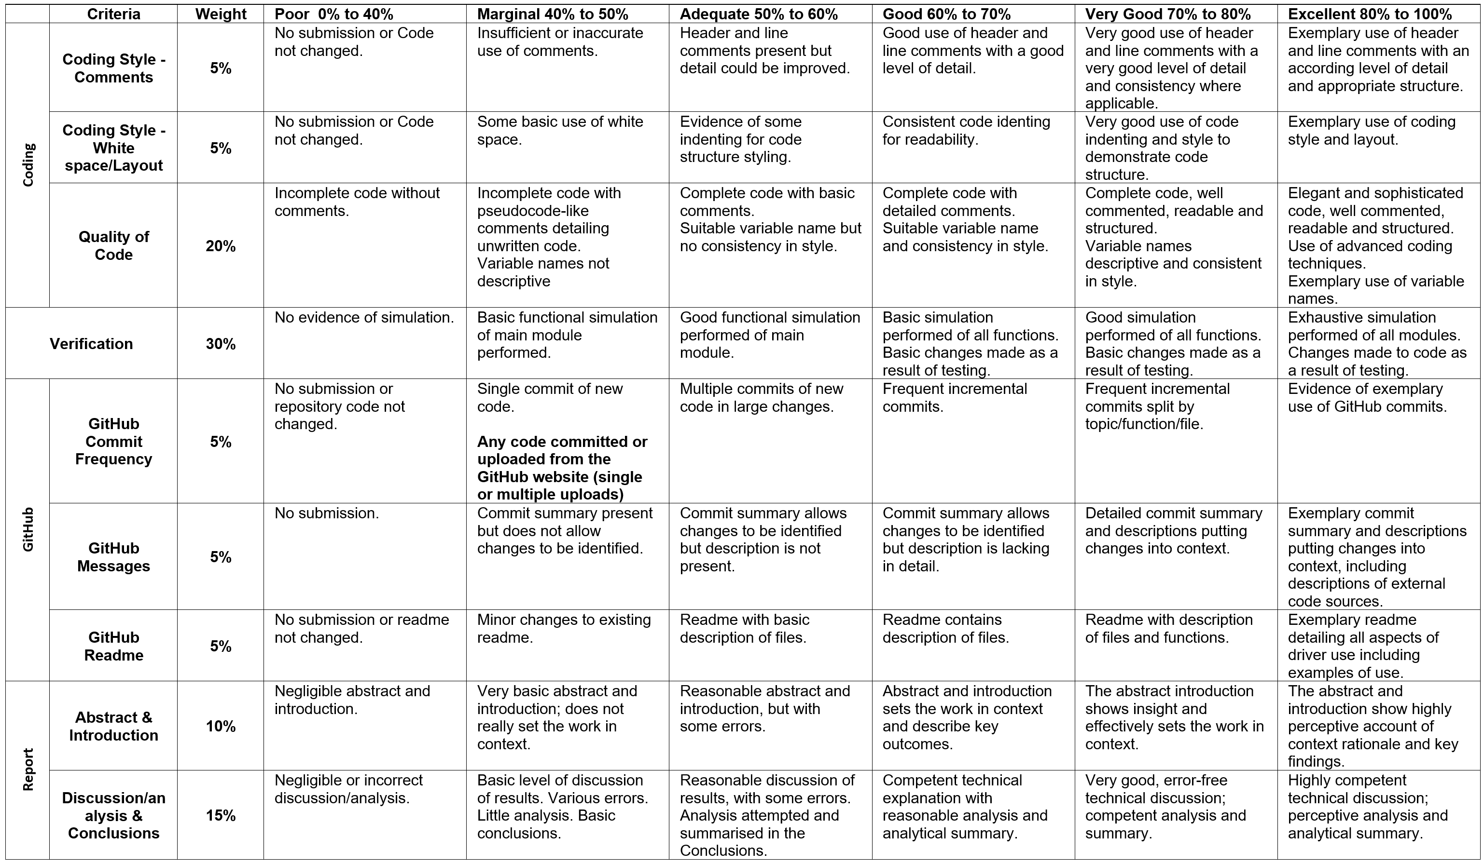

Slide 8
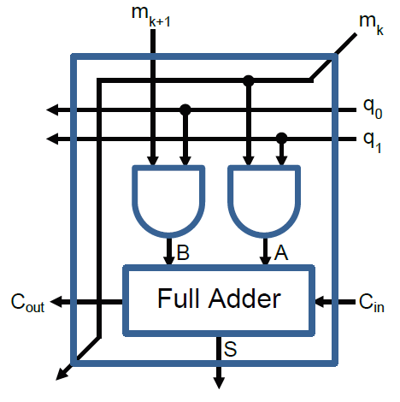
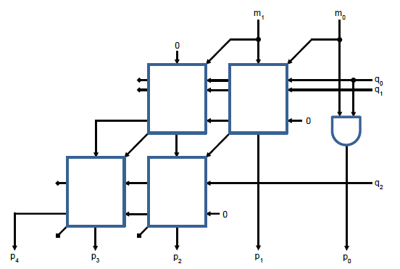
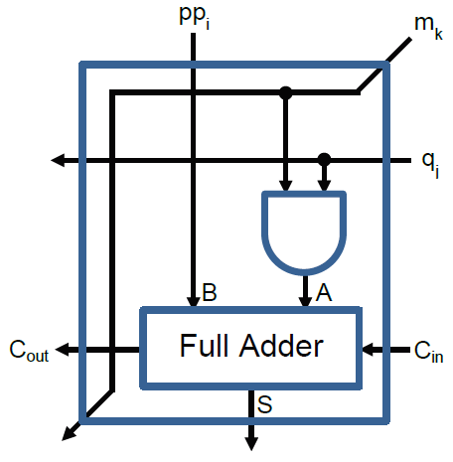
GitHub Upload Task 2x3 bit multiplier

Slide 9
Unit 1.2: Behavioural Verilog
Task recap

Slide 10
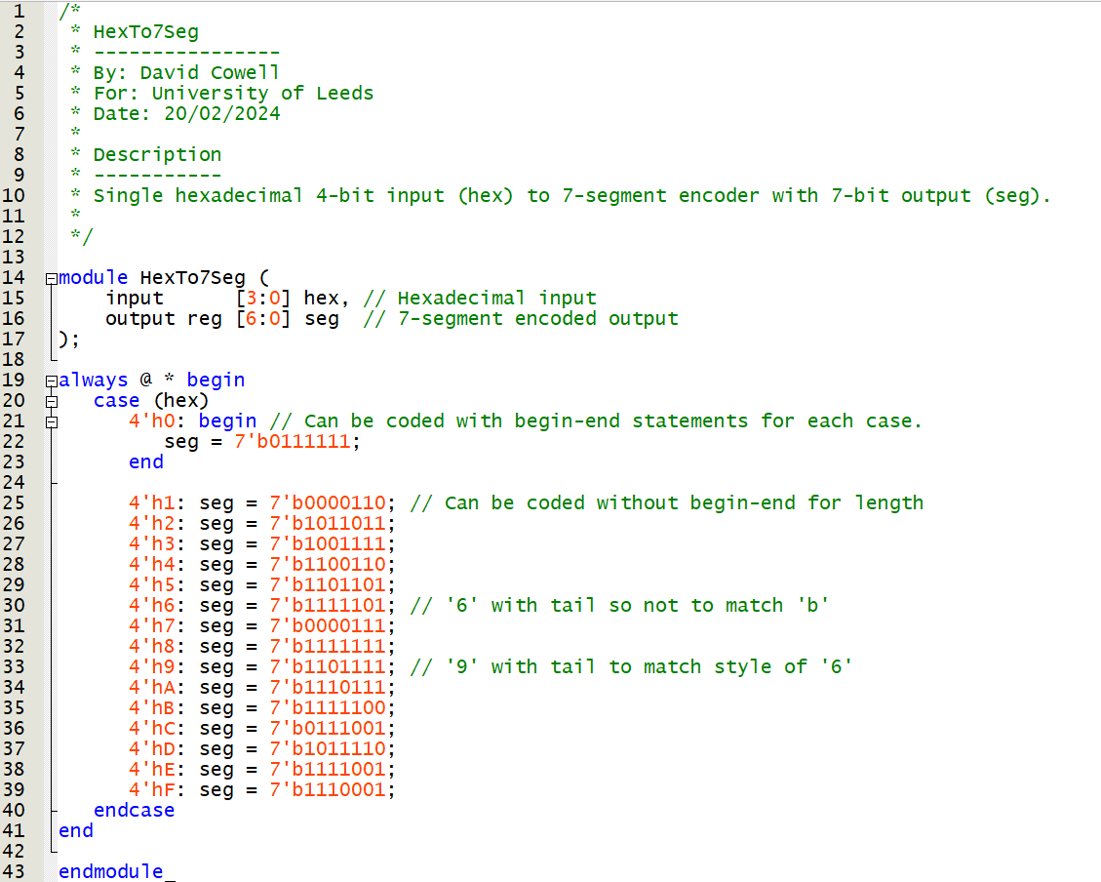
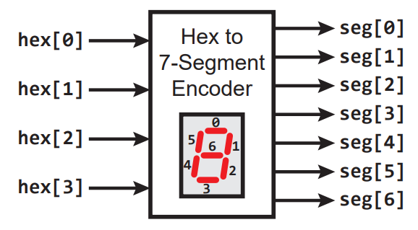
Unit 1.2: Behavioural Verilog Task 1: Hexadecimal to 7-segment Encoder

Slide 11
Unit 1.2: Behavioural Verilog Task 1: Hexadecimal to 7-segment Encoder
≠

Slide 12
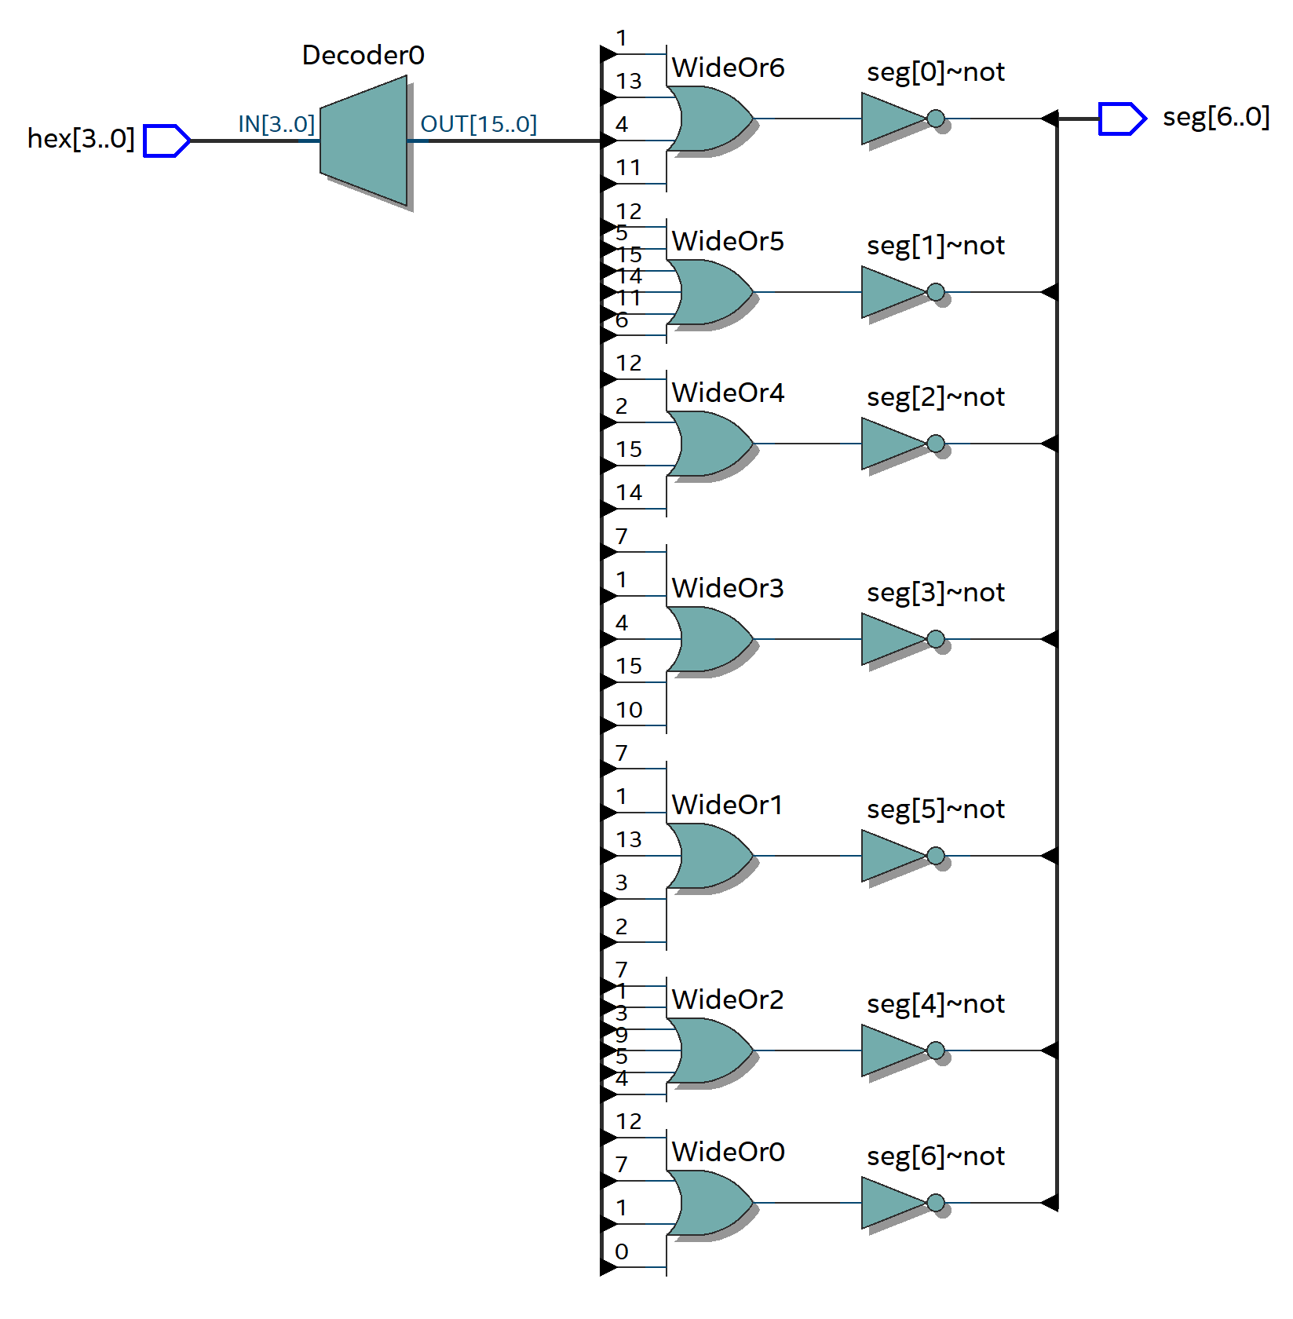
Unit 1.2: Behavioural Verilog Task 1: Hexadecimal to 7-segment Encoder
Hex[3:0] decoded to internal [15:0] signal
Logic gates determine low outputs (unlit segs)
Not gate inverts to create high desired outputs.
Look at output bit seg[6] – middle segment
Inputs 0, 1, 7 and C (12) – seg[6] is unlit
or-gate output high for these inputs
not-gate inverts for correct output

Slide 13
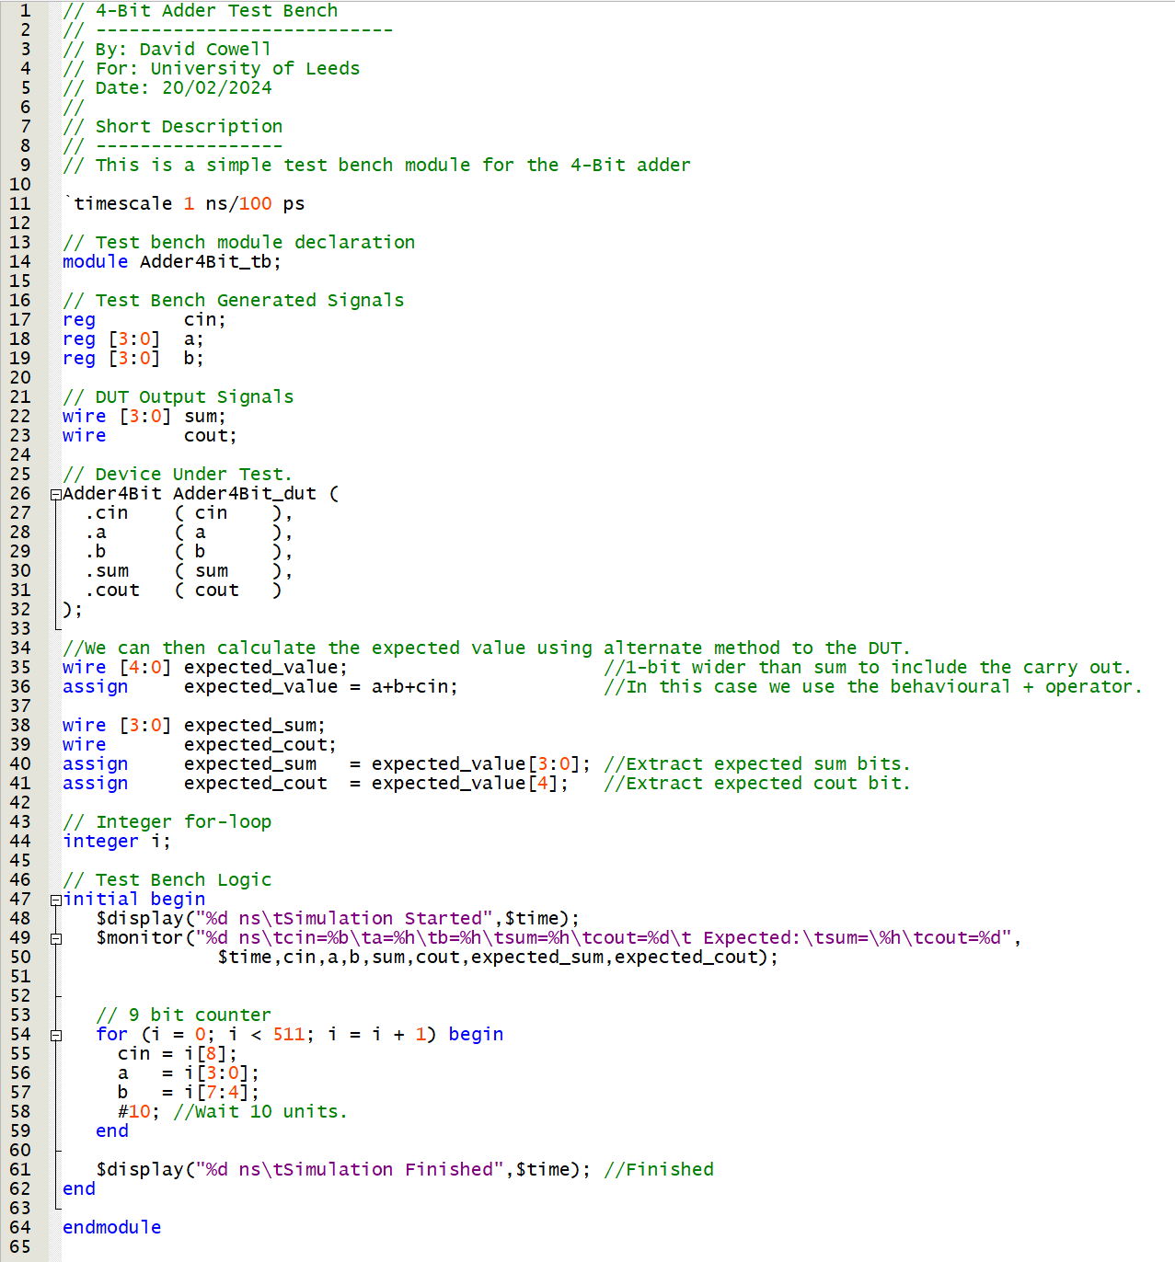
Unit 1.2: Behavioural Verilog Task 3: 4 bit Adder Simulation
Registers and wires for DUT
DUT
Expected value calculation
Expected value separation into sum and cout
for-loop to cycle through all 512 values
512 = 2^9 = 9 bit = 4 bit (a)+ 4 bit (b)+1 bit (cin)
Separate counter i into inputs to a, b and cin

Slide 14
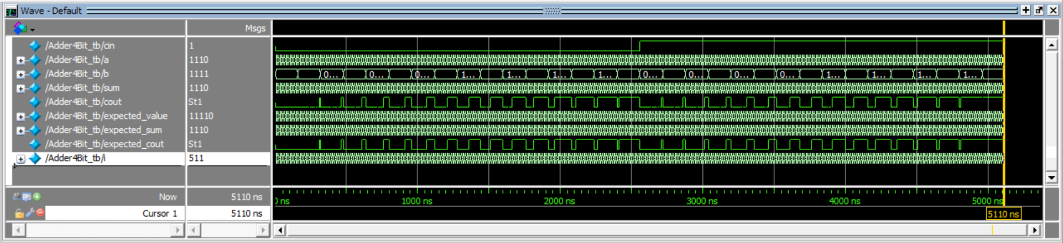
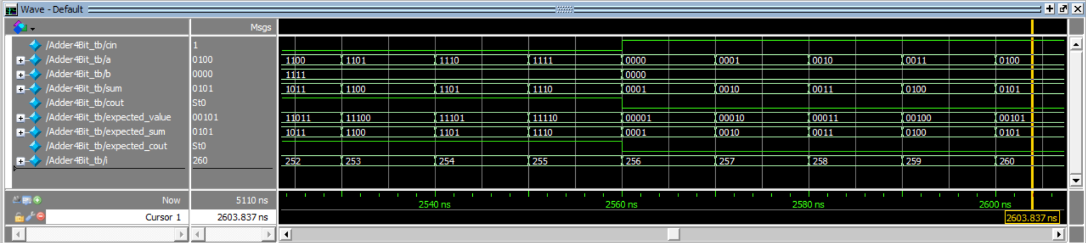
Unit 1.2: Behavioural Verilog Task 3: 4 bit Adder Simulation

Slide 15
ELEC5566M FPGA Design for System-on-Chip
Unit 2.1
Prof Steven Freear Module Leader s.freear@leeds.ac.uk
Dr David Cowell

Slide 16
Unit 2.1: Synchronous Logic
Synchronous Sequential Logic
Hardware Parameterisation
Verilog Test Benches Continued

Slide 17
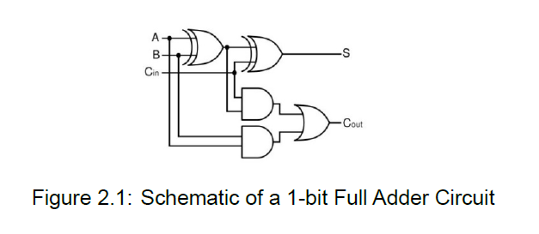
Synchronous Sequential Logic
Combination Logic (covered in Unit 1)
Output depends only on the current input
Sequential Logic : To build more complex circuits– useful if the output can depend on previous input values or historical inputs.
e.g. counters, shift registers, processors.
When aligned with a clock – known as Synchronous Sequential Logic
Notes:
Sequential important so we can have a history of data but also for data validity.

Slide 18

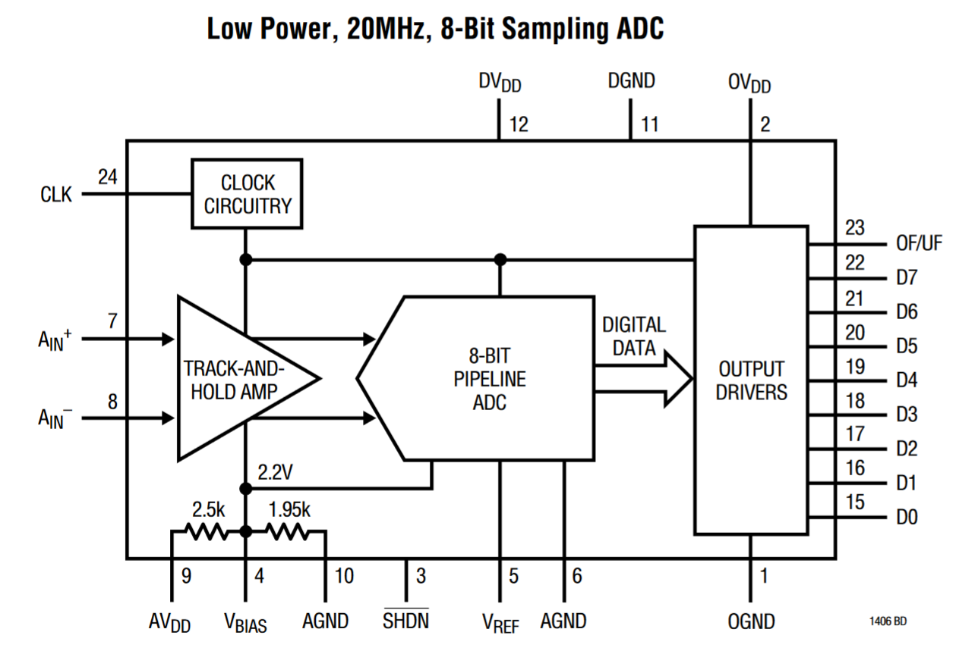
Why is Synchronous Logic Important?
Let us take an example of an Analogue to Digital Converter (ADC)
A typical input to an FPGA
8 bit resolution 20Msps sample rate
Multiple bits changing! Data validity is aligned to a clock
https://www.analog.com/media/en/technical-documentation/data-sheets/1406f.pdf
Notes:
Historical values important
e.g. Filtering (averaging a simple example of a filter)
Alignment to a clock important.
What happens if data is wrong
Maybe not too catastrophic with ADC
But (e.g. financial data?)

Slide 19
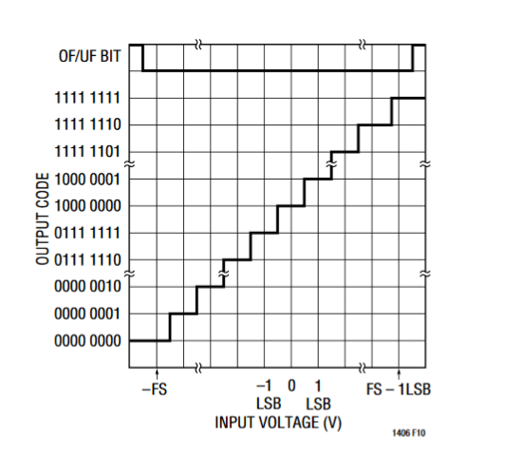
Digitization - Quantization
Analogue input quantized
For the LTC1406 example
8 bit resolution
256 discrete samples
Representing linear +1 volt to -1 volt
Your design needs to consider number system
Notes:
In a similar way that time is quantised, the amplitude is qualtised.
Note the range of values is linear – this is not floating point – which can cover a larger range.
Even with binary coding – need to be careful how –ve numbers are represented and interpreted. E.g. HEX display as an output.

Slide 20
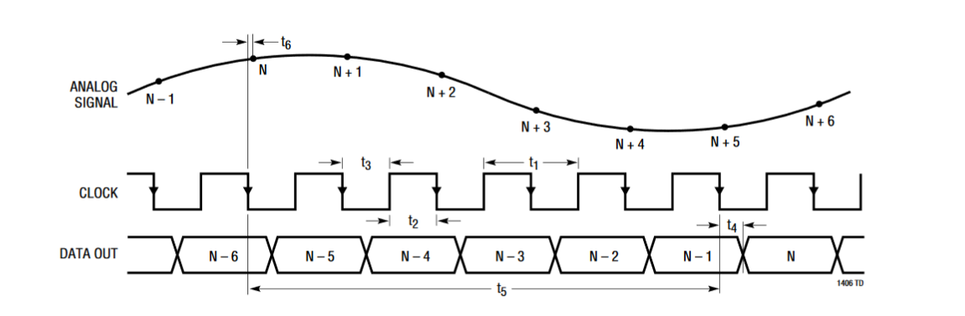
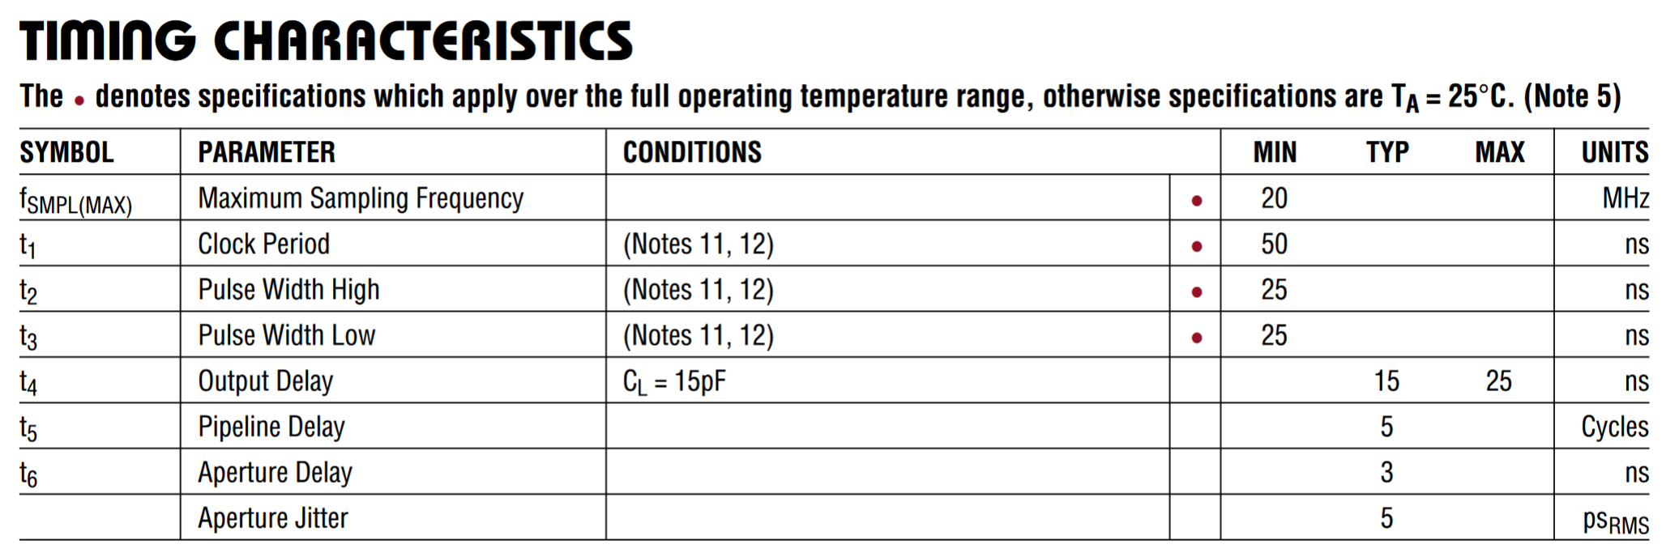
Time Domain Quantization
Notes:
As the amplitude is quantised so is the time domain quantisation. Still need to be careful of pipeline delays.
Important point to be aware of is the mis-alignment between the point of sampling and the number of clocks cycles until the output

Slide 21
Time Domain Quantization
10 ns of uncertainty.
Not all 8 bit outputs will change at the same time
Notes:
Accuracy and relationship of data valid need to be understood – (e.g. financial data !)

Slide 22
Time Domain Quantization
5 clocks cycles delay
Notes:
Accuracy and relationship of data valid need to be understood – (e.g. financial data !)

Slide 23
Synchronous Logic Ensures Data Alignment
Procedural statements such as if and else must always be contained within an always block:
always @(a or b or c)‏
begin
// Procedural statements go here!
end
Always is triggered when the inputs listed after the @ change value:
always @(posedge a) – triggered by a rising clock edge
always @(a) – triggered by change in value of a
This list of inputs is known as the sensitivity list
Statements within an always block execute sequentially
Multiple always blocks within a module execute in parallel.
Notes:
So how do we instantiate with Verilog? – called procedural statement.

Slide 24
Procedural Statement and Synchronous Logic
The format of the sensitivity list determines the type of logic implemented by the always block.
always@(a)‏
Block is implemented as combinatorial asynchronous logic.
Use blocking assignments (=)‏
always@(posedge a)
Block is implemented as sequential synchronous logic.
Can use posedge or negedge depending if we want trigger on rising or falling edge of the clock signal
Use non-blocking assignments (<=)‏

Slide 25
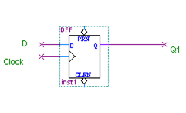
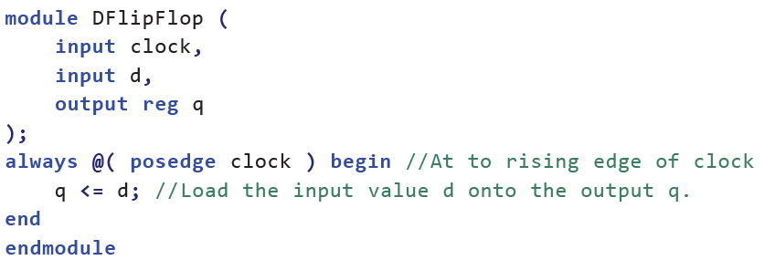
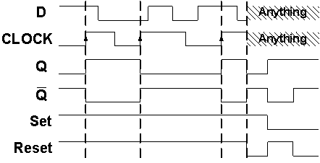
D type Flip Flop – example of a synchronous circuit
Note the code is written for 1 bit but for the ADC example there would be 8 parallel D type flip flops…
To precisely align and latch the ADC data into the FPGA.
Notes:
You may have noticed in Listing 1.1and Listing 1.2 that we have subtly introduced a new Verilog operator, <=. This appears to resemble the logical operator less than or equal, however it is in fact the non-blocking assignment operator.
When using synchronous logic, we will normally expect all of our registers to be updated at the same time synchronous to the same clock edge. For this we must use the so called a non-blocking assignment

Slide 26
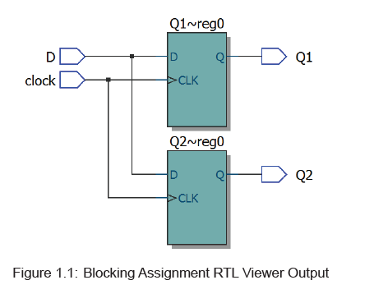
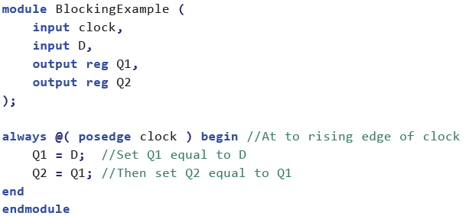
Blocking versus Non-Blocking
Blocking Example
Notes:
1.4.1 Blocking Assignments
In Listing 1.3, we use the blocking assignment as you have done in previous labs. When this type of assignment is used, each line of code will be evaluated in the order in which they appear. Each subsequent line of code in the always block will be calculated after the previous blocking assignment has been completed. This is just what we would expect from any standard high-level programming language.
However, with Verilog it is important to recall that we are not programming instructions to be executed, we are designing hardware. Once converted to hardware, both assignments in the above code example will in fact be executed at the same time, during the exact same clock cycle. It may sound confusing at first, so let’s consider how both requirements (blocking and simultaneous) can be fulfilled.
The easiest way to understand why this happens is as follows.
Visualise that each assignment operator is calculated internally in order, line-by-line, updating a local value of each of the registers.
Once the end statement is reached, the value of the local copy for each register is simultaneously updated on to the actual register outputs.
Essentially this is like having a C function whereby calculations are done within the function and the results are updated when the function returns.

Slide 27
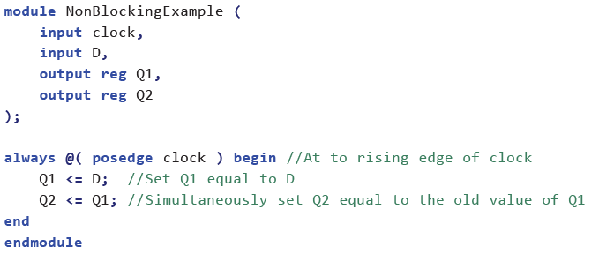
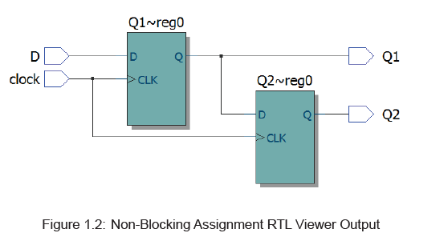
Blocking versus Non-Blocking
Non-Blocking Example
Notes:
When we use non-blocking assignments, each assignment value is calculated simultaneously, thus the order of the statements will not affect the behaviour of the logic
As we did before, let’s examine the behaviour of each assignment.
The calculation for Q1 is unchanged, it will still simply be assigned D at the end of the always block.
However, the calculation for Q2 is now different.
When the clock edge happens, both assignments are calculated simultaneously which means that the value assigned to Q2 will be the previous value of Q1
— the new value of Q1 hasn’t yet changed when Q2 is calculated.
The resulting inferred behaviour changes dramatically as is evident as shown (Figure 1.2)
We can see from the RTL output how Q2 is no longer being assigned the value of D as in the previous example. Because both flip-flops are triggered simultaneously by the same clock edge, Q2 must take the value that Q1 had before the clock edge occurred. This register-to-register transfer behaviour is guaranteed to function, and it relied upon heavily in synchronous designs where data and calculation results are passed through chains of registers.
We typically use Non-Blocking assignments for synchronous logic circuits.

Slide 28
Other Examples of Synchronous Logic
Flip Flops
Shift Registers
Counters
Memory blocks
First-in-first-out (FIFO) memory
Notes:
Sequence and data integrity are very important
A missed sample on an ADC might not be important but transmission protocols often require the writing of parameters to establish a link e.g. Bluetooth. If data is missing things wont work – the connection wont be established.
fiscal metering, financial data, tran

Slide 29
Hardware Parameterisation

Slide 30
Hardware Parameterisation
Modularisation of code
Generalised Functions
Rather than design a 4-bit counter design an n-bit counter
Add module parameter list to the module declaration #( …)
Notes:
Powerful being able to describe and wrap a block of hardware as ageneralised function that can be re-used. E.g. ARM processor – a fabless seminconductor company.

Slide 31
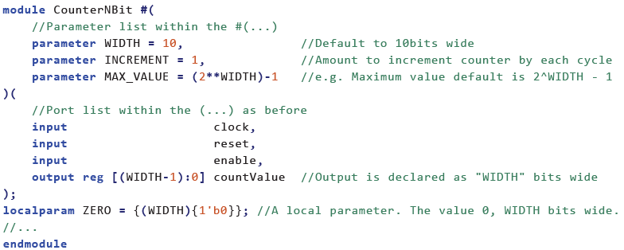
Verilog Parameter Lists – an example
N-Bit Counter Example

Slide 32
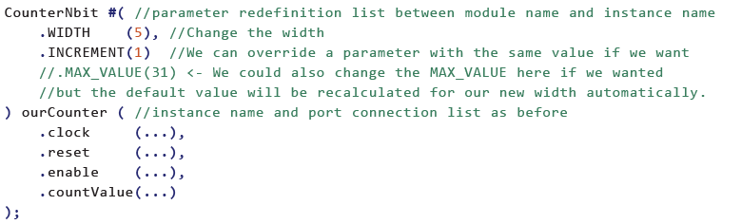
Instantiating Parameterised Modules
Example Instantiating a 5-bit counter

Slide 33
Importance of Parameterisation
Vendor Specific Soft IP – Non portable!
Library of parameterised modules (LPM) – Basic building blocks
DSP, Interface Protocols, Memory Interfaces & Controllers, Processors and Peripherals https://www.intel.com/content/www/us/en/programmable/quartushelp/13.0/mergedProjects/hdl/mega/mega_list_mega_lpm.htm
Vendor Specific Hard IP – Non portable!
DSP blocks, Memory, SerDes, Hard Processors, PCIe Interfaces, DDR Controllers etc…
Commercial Soft IP – Portable?
Guaranteed function – Expensive – Legal Protection – Support
Your own verified Verilog modules! – Portable!!!
Guaranteed function – Adaptable – Support
Open-source community – e.g. http://www.opencores.com
Unverified α / β code - no warranty on non-commercial IP. Licensing?!

Slide 34
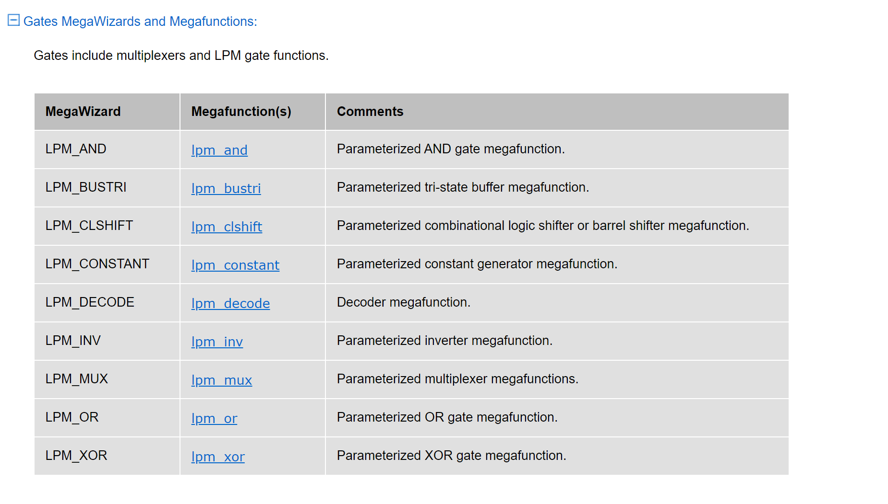
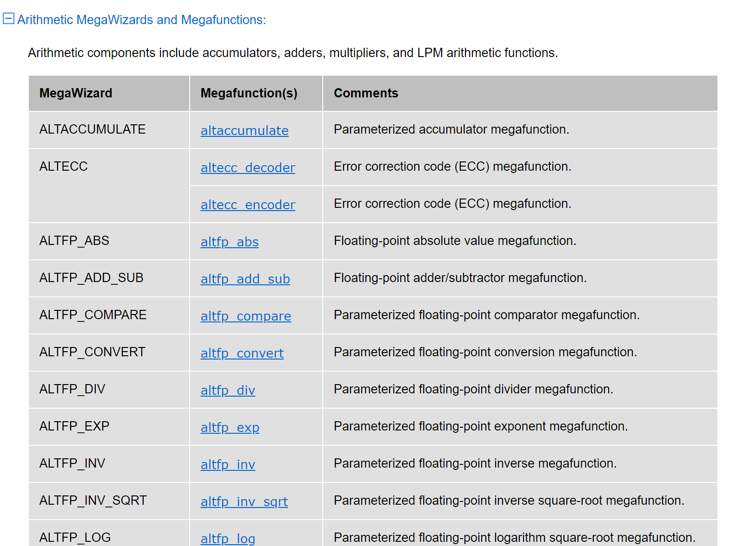
Altera / Intel Library Parameterised Modules - examples

Slide 35
Simulating Synchronous Sequential Circuits

Slide 36
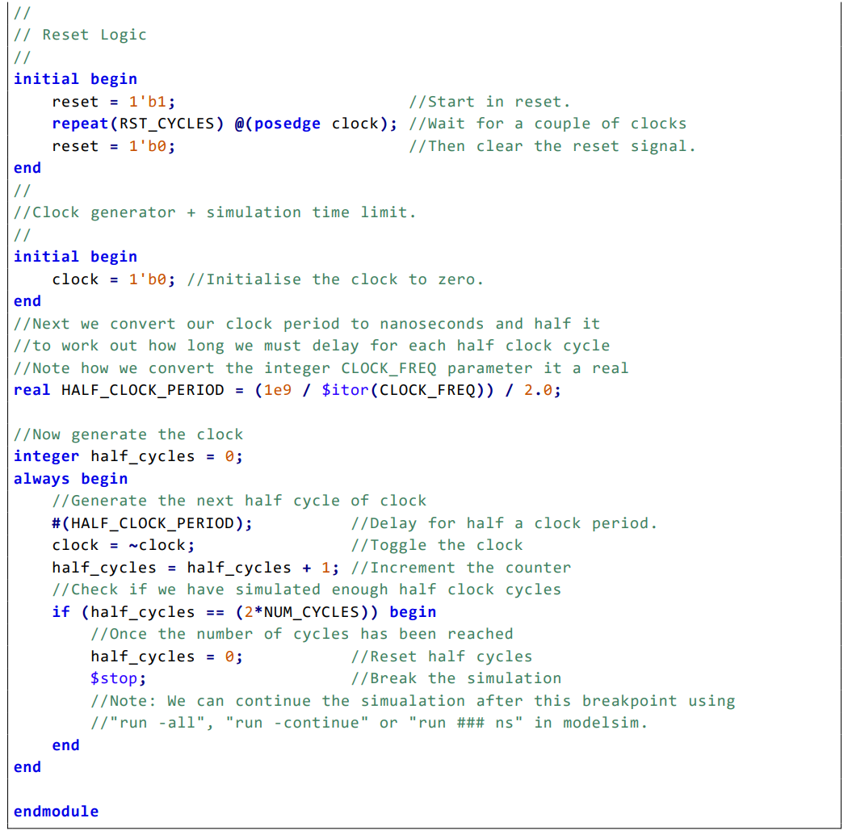
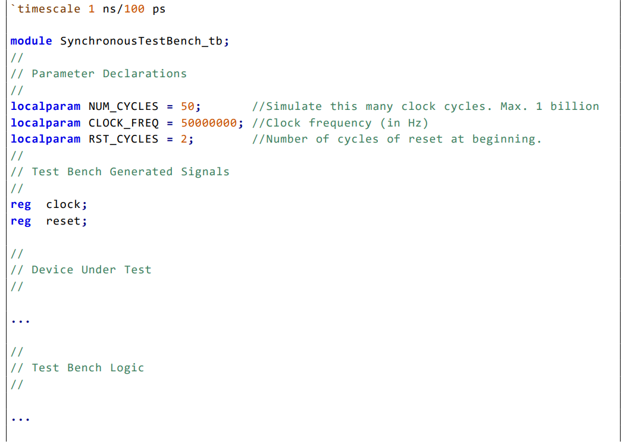
Testbenches
Local parameters to configure Clock and Reset signal generation
Registers for ‘storing’ Clock and Reset signal values
Instantiate the DUT.
Create other input signals for by DUT

Slide 37
Testbenches
Initial block – only runs once.
Generates the Reset Signal
Initial block Sets the original clock value
Calculation of half clock period based on clock frequency
Clock generation with maximum simulation duration

Slide 38
Testbenches
Note the always block. This repeats forever
… or until a $stop command is issued

Slide 39
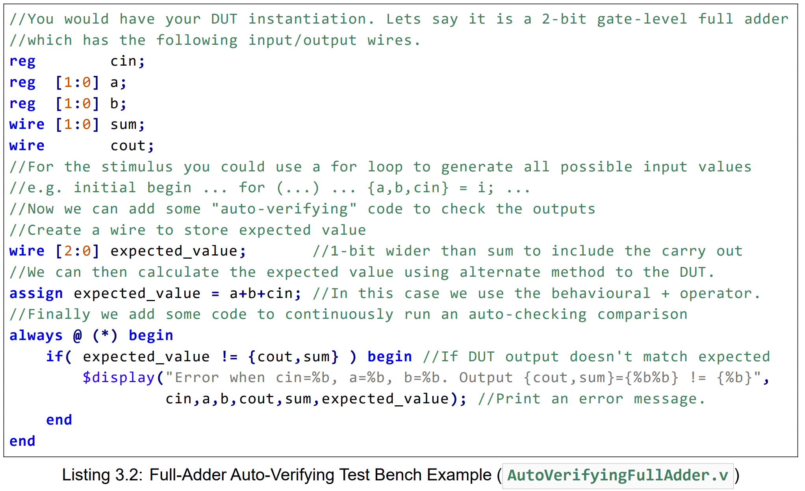
Auto-Verifying Testbench
Calculate the expected output…
… ideally using different code to DUT.
Constantly check if the expected output value is not equal to the DUT output.
Note the concatenation of cout and sum!

Slide 40
Have fun and enjoy the embedded modules!

